Slide 1
POS(Parts-Of-Speech) Tagging in NLP

Slide 2
PoS Tagging
Parts of Speech (POS) tagging is an NLP task where each word in a text is assigned a grammatical category like noun, verb, adjective, etc.
It adds syntactic and semantic context, aiding in sentence structure and meaning understanding.
POS tagging supports tasks like machine translation, named entity recognition, and information extraction.
It also helps resolve word ambiguity and reveals grammatical structure.

Slide 3
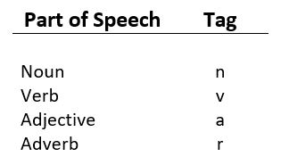
PoS Tagging

Slide 4
Default Tagging in POS Tagging
Default tagging is the simplest POS tagging technique where every word is assigned the same tag, regardless of its context or meaning.
It serves as:
A baseline model in POS tagging.
A fallback for unknown or unseen words.
from nltk.tag import DefaultTagger
tagger = DefaultTagger('NN')
Here, 'NN' is the POS tag for singular noun.
Example:
tagger.tag(['I', 'saw', 'a', 'cat'])
Output:
[('I', 'NN'), ('saw', 'NN'), ('a', 'NN'), ('cat', 'NN')]
Every word gets tagged as 'NN' — even if it’s not a noun.

Slide 5
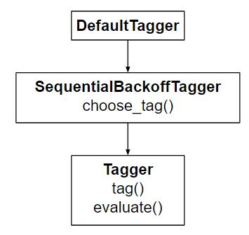
Class hierarchy and method inheritance of the Default Tagger
DefaultTagger
It's a tagger that gives every word the same tag — like calling every word a noun.
SequentialBackoffTagger
This class helps in falling back to another tagger when the current one can’t decide a tag.
It has a method called choose_tag() which tries to pick a tag.
If it can’t, it says: “Let me ask another tagger!”
So, DefaultTagger uses this to always give a default tag (like 'NN' for noun), if no better option is found.

Slide 6
Class hierarchy and method inheritance of the Default Tagger
Tagger
This is the main base class for all taggers.
It has:
tag() → for tagging words in a sentence.
evaluate() → for checking how accurate the tagging is using correct answers (labeled data).
🔹 DefaultTagger is the child
🔹 SequentialBackoffTagger is the parent
🔹 Tagger is the grandparent

Slide 7
POS Example
The quick brown fox jumps over the lazy dog.”

Slide 8
Word | POS Tag | Meaning of Tag
The | DT | Determiner (e.g., a, the, some) – introduces a noun
quick | JJ | Adjective – describes a noun
brown | JJ | Adjective – adds another description
fox | NN | Noun – a person, place, or thing (in this case, an animal)
jumps | VBZ | Verb (3rd person singular) – an action done by "fox"
over | IN | Preposition – shows relationship (fox jumps over something)
the | DT | Determiner – again introducing a noun
lazy | JJ | Adjective – describes the dog
dog | NN | Noun – the object being jumped over

Slide 9
Workflow of POS Tagging in NLP
Tokenization: Divide the input text into discrete tokens, which are usually units of words or subwords. The first stage in NLP tasks is tokenization.
Loading Language Models: To utilize a library such as NLTK or SpaCy, be sure to load the relevant language model. These models offer a foundation for comprehending a language’s grammatical structure since they have been trained on a vast amount of linguistic data.
Text Processing: If required, preprocess the text to handle special characters, convert it to lowercase, or eliminate superfluous information. Correct PoS labeling is aided by clear text.

Slide 10
Workflow of POS Tagging in NLP
Linguistic Analysis: To determine the text’s grammatical structure, use linguistic analysis. This entails understanding each word’s purpose inside the sentence, including whether it is an adjective, verb, noun, or other.
Part-of-Speech Tagging: To determine the text’s grammatical structure, use linguistic analysis. This entails understanding each word’s purpose inside the sentence, including whether it is an adjective, verb, noun, or other.
Results Analysis: Verify the accuracy and consistency of the PoS tagging findings with the source text. Determine and correct any possible problems or mistagging.

Slide 11
Rule-Based POS Tagging?
Rule-based POS tagging uses a set of human-made rules (grammar rules) to decide the POS tag of each word in a sentence.
How Does It Work? (Step-by-Step)
Lexicon Lookup
First, it checks a dictionary (lexicon) that says which words are usually which parts of speech.
"run" could be a noun or a verb.
Apply Rules Based on Context
It applies rules based on the word's position and neighboring words.
Example rules:
If a word comes after "the" and is unknown, it's likely a noun.
If a word ends in "-ly", it's likely an adverb.
Disambiguation
If a word has multiple possible tags (like "run"), it uses rules to choose the correct one based on the sentence structure.

Slide 12
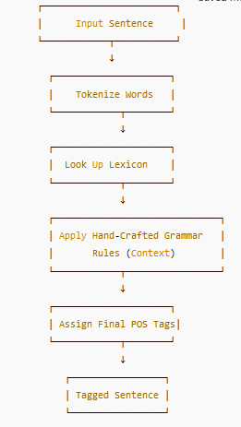

Slide 13
Transformation Based tagging
Transformation-based tagging (TBT) is a part-of-speech (POS) tagging method that uses a set of rules to change the tags that are applied to words inside a text
It draws the inspiration from both the previous explained taggers − rule-based and stochastic.
Steps
Start with the solution − The TBL usually starts with some solution to the problem and works in cycles.

Slide 14
Transformation Based tagging
Baseline Tagging: Assign each word its most likely POS tag (e.g., based on frequency or dictionary lookup).
Compare with Gold Standard: Compare this initial tagging with the correct tags in a manually tagged corpus.
Learn Transformation Rules: Identify rules like:
Change tag A to tag B when a certain condition is met.
Apply Best Rule: Select the rule that reduces the most tagging errors.
Repeat: Apply the rule, update the tagged text, learn the next best rule.
Stop when no rules improve accuracy.

Slide 15
Transformation Based tagging
Example
Sentence:
"Book that flight."
Now, the word "Book" can be:
a NOUN: I read a book.
a VERB: Book the tickets.
Let’s say the robot tags it like this first (guessing):
Book/NOUN that/DET flight/NOUN
But the correct answer is:
Book/VERB that/DET flight/NOUN
The Robot Learns a Rule:
If a word is “Book” and it’s at the start of a sentence,
Change tag from NOUN → VERB

Slide 16
Markov Model Approaches
Markov Model?
A Markov Model is a mathematical model that assumes
The future state depends only on the current state, not on the past states. This is called the Markov Property.
There are 4 main approaches (levels of complexity) of Markov Models:
1. Markov Chain (Observable Markov Model)
States are observable
Transitions happen between states based on a probability
Example:
Weather prediction
States: {Sunny, Rainy, Cloudy}
Model learns the probability of switching from one weather type to another.
𝑃(Today = Rainy | Yesterday = Sunny)
P(Today = Rainy | Yesterday = Sunny)

Slide 17
Markov Model Approaches
Hidden Markov Model (HMM)
States are hidden, we only see the outputs (observations)
There are two types of probabilities:
Transition probability (hidden → hidden)
Emission probability (hidden → observed)
Example:
POS tagging
States = POS tags (hidden)
Observations = Words in the sentence
𝑃(NOUN → VERB)
𝑃("play" | VERB)
P(NOUN → VERB)⋅P("play" | VERB)

Slide 18
Markov Model Approaches
3. Maximum Entropy Markov Model (MEMM)
A discriminative model, unlike HMM (which is generative)
Uses features from the observation sequence (e.g., current word, previous tags)
Better at handling overlapping features
Example Use Case: Named Entity Recognition (NER)
4. Conditional Random Field (CRF)
A sequence modeling technique like HMM/MEMM but more powerful
Considers the entire sequence of observations and labels
Handles dependencies between output labels
Used in: POS tagging, NER, Chunking

Slide 19
Hidden Markov Model POS tagging,
It’s a machine learning method that helps a computer figure out the part of speech (POS) (like noun, verb, adjective) for each word in a sentence by using probabilities.
The computer plays a smart game of:
“Based on the words I see, and the tags I’ve seen before, what’s the most likely tag for this word?”
It uses two things:
How likely a word is to have a certain tag
→ This is called emission probability
How likely one tag is to follow another
→ This is called transition probability

Slide 20
Hidden Markov Model POS tagging,
“I can fish.”
This sentence is ambiguous:
“can” could be a modal verb (like “I can swim”)
“fish” could be a noun or a verb
Emission Probability:
How often does the word “can” appear as a VERB or as a NOUN?
Example:
P(can | VERB) = 0.7
P(can | NOUN) = 0.3
Transition Probability:
How often does a VERB come after a PRONOUN like “I”?
Example:
P(VERB | PRONOUN) = 0.8
P(NOUN | PRONOUN) = 0.2
I can fish
Prnoun VERB VERB ← most likely sequence

Slide 21
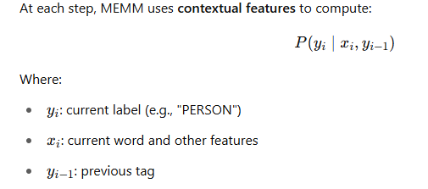
Maximum Entropy Markov Model
It is a discriminative model used for sequence labeling tasks like:
POS tagging
Named Entity Recognition (NER)
Chunking
Task:
Label each word in a sentence with tags like:
PER = person
LOC = location
ORG = organization
O = other (not an entity)

Slide 22
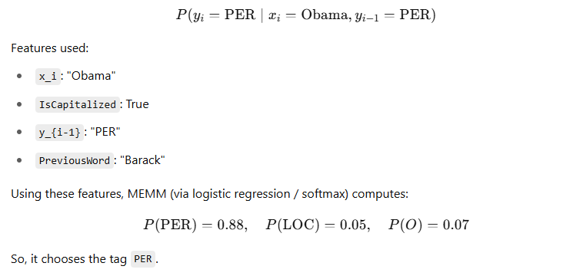
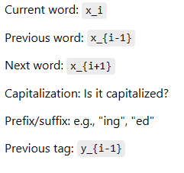
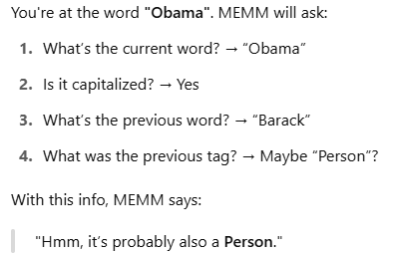
Maximum Entropy Markov Model
Barack Obama was born in Hawaii
[Barack] PER
[Obama] PER
[was] O
[born] O
[in] O
[Hawaii] LOC

Slide 23
Training a unigram part-of-speech tagger
A unigram simply means one word.
So, a Unigram Tagger uses only one word at a time to decide what its part of speech (POS) is (like noun, verb, adjective, etc.).
UnigramTagger can be trained by giving it a list of tagged sentences at initialization.
>>> from nltk.tag import UnigramTagger
>>> from nltk.corpus import treebank
>>> train_sents = treebank.tagged_sents()[:3000] #Training
>>> tagger = UnigramTagger(train_sents) # List of words
>>> treebank.sents()[0] # Tagging
Output
[('Pierre', 'NNP'), ('Vinken', 'NNP'), (',', ','), ('61', 'CD'),
('years', 'NNS'), ('old', 'JJ'), ...]

Slide 24
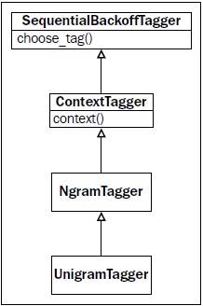
How it works
Unigram Tagger is like a child that inherits behavior from parent classes above it.
Class | Main Job
SequentialBackoffTagger | Provides choose_tag() method. It’s like a smart guesser.
ContextTagger | Requires a method called context() that defines what context to use when tagging a word.
NgramTagger | Handles n-gram logic (unigram, bigram, etc.).
UnigramTagger | Overrides the context() method to say: “My context is just the word itself.”

Slide 25
How it works
Why context()?
In tagging, we often want to use context (like nearby words) to decide what tag to use.
Unigram Tagger says:
➤ “I’ll just use the word itself as context.”
This means that for the word “AIML”, it will remember how “AIML" was tagged in the training data.
How It Works in Code Terms
UnigramTagger inherits a choose_tag() method from SequentialBackoffTagger.
But to use it, it must define context() (from ContextTagger), which tells the tagger what input to base decisions on.
For UnigramTagger, context() just returns the word.

Slide 26
Combining taggers with backoff tagging
Combine taggers using backoff, we're creating a chain of taggers so that if one tagger cannot tag a word, it passes the task to the next tagger in line.
Why Backoff?
Not every tagger knows all words. For example:
A UnigramTagger tags based only on individual words seen during training.
If it sees a new word, it returns None.
To fix this, we add a backoff tagger — like a DefaultTagger, which assigns a default tag (like 'NN' for noun) when no other tagger works.
How It Works (Simple Analogy)
Think of it like:
Ask the UnigramTagger: “Do you know this word?”
If it says No, ask the next tagger (e.g., BigramTagger).
If no one knows, finally ask the DefaultTagger who always says “It’s a noun!”

Slide 27
How it works
When we use SequentialBackoffTagger (which is the parent class of UnigramTagger, BigramTagger, etc.), it maintains a list of all taggers in a chain — called _taggers.
Example
Imagine you're trying to figure out the meaning of a word. You ask people in this order:
Expert A (UnigramTagger)
If A doesn’t know, ask Expert B (BigramTagger)
If B also doesn’t know, ask Expert C (DefaultTagger, who always says “noun”)
This list of experts is stored inside _taggers.

Slide 28
How it works
Example Code
from nltk.tag import DefaultTagger, UnigramTagger
# Backoff tagger: always returns 'NN' (noun)
tagger1 = DefaultTagger('NN')
# Unigram tagger with backoff to tagger1
tagger2 = UnigramTagger(model={'hello': 'UH'}, backoff=tagger1)
# Internally, this happens:
print(tagger1._taggers) # ➜ [tagger1]
print(tagger2._taggers) # ➜ [tagger2, tagger1]
Output
tagger2.tag(['hello', 'world'])
Here's what happens:
'hello': tagger2 finds it in its model → returns 'UH'
'world': tagger2 doesn't know it → asks tagger1 → returns 'NN'

Slide 29
Training and combining ngram taggers
What are Ngram Taggers?
An NgramTagger uses n-1 previous words and tags to predict the current word's tag.
UnigramTagger = uses the current word only
BigramTagger = uses the previous one word/tag
TrigramTagger = uses the previous two words/tags
These become smarter as the N increases but need more data to work well.
So we combine them with backoff:
Try trigram → if fail, try bigram → if fail, try unigram → if fail, use default.
What is The Problem
Some words change their meaning (and part of speech) based on the context.
For example:
In “tag this post” → tag is a verb
In “This is a tag” → tag is a noun
Just looking at the word itself isn’t always enough. We need to look at the surrounding words (context).
That’s why we use NgramTaggers like BigramTagger and TrigramTagger, which look at 1 or 2 previous words/tags to decide the correct tag.

Slide 30
Training and combining ngram taggers
def backoff_tagger(train_sents, tagger_classes, backoff=None):
for cls in tagger_classes:
backoff = cls(train_sents, backoff=backoff)
return backoff
Loop
First, UnigramTagger(train_sents, backoff=DefaultTagger('NN'))
Then, BigramTagger(train_sents, backoff=UnigramTagger)
Then, TrigramTagger(train_sents, backoff=BigramTagger)

Slide 31
Quadgram tagger
A QuadgramTagger looks at the previous 3 tagged words to decide the tag of the current word. That means it uses 4-gram context: 3 past words + current word.
It’s built using NLTK’s NgramTagger by setting n=4:
from nltk.tag import NgramTagger
quadtagger = NgramTagger(4, train_sents)
quadtagger.evaluate(test_sents)
# Output: ~0.0582 (very low accuracy)
Why so bad?
Because most sentences are not long enough for a quadgram model to learn reliable patterns.
The more history it requires, the less data it finds matching that exact history.
So it ends up tagging very few words.

Slide 32
Quadgram tagger
Custom QuadgramTagger Class
Instead of writing NgramTagger(4, ...) directly every time, we create a custom class:
from nltk.tag import NgramTagger
class QuadgramTagger(NgramTagger):
def __init__(self, *args, **kwargs):
NgramTagger.__init__(self, 4, *args, **kwargs))

Slide 33
Creating a model of likely word tags
Creating a model of likely word tags means building a part-of-speech (POS) tagger that predicts the most likely tag for a word based on how it appears in training data.
One of the simplest ways to build such a model is by using a UnigramTagger from NLTK. This tagger learns the most likely tag for each word in the training data, ignoring context.
For example, if the word "bank" is most often used as a noun (NN) in your training sentences, then the UnigramTagger will always tag it as NN, even if sometimes it's used as a verb.
This creates a simple word → most likely tag mapping.

Slide 34
Creating a model of likely word tags
What’s the Goal?
We want to build a tagging model that can guess the part-of-speech (POS) tag of the most common 200 words in the corpus (like "the", "is", "bank", etc.) — using the tag that is most frequently associated with each word.
def word_tag_model(words, tagged_words, limit=200):
fd = FreqDist(words) # Count word frequencies
cfd = ConditionalFreqDist(tagged_words) # Count tag frequencies per word
most_freq = (word for word, count in fd.most_common(limit)) Get the top 200 most common words
return dict((word, cfd[word].max()) for word in most_freq) For each of the 200 words, find its most common tag

Slide 35
Affix Tagging?
Affix tagging is a part-of-speech (POS) tagging method that uses prefixes and suffixes (collectively called affixes) of words to guess their grammatical category.
Word | Suffix | Likely POS
running | -ing | Verb (present participle)
national | -al | Adjective
happiness | -ness | Noun
preheat | pre- | Verb

Slide 36
Affix Tagging?
Key Points
affix_length=3 → looks at first 3 letters (prefix)
affix_length=-3 → looks at last 3 letters (suffix)
It learns patterns from training sentences (like “words ending in -ing are usually verbs”).
If it can’t decide, it returns None or uses a backoff tagger (if provided).
>>> from nltk.tag import AffixTagger
>>> tagger = AffixTagger(train_sents)
>>> tagger.evaluate(test_sents)

Slide 37
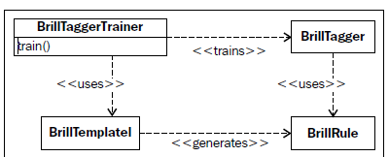
Training a Brill tagger
Training a Brill Tagger is a way to improve part-of-speech (POS) tagging by learning correction rules from tagged text.
It’s a rule-based tagger.
It begins with a base tagger (like a unigram tagger).
Then it learns transformation rules like:
"If a word is tagged NN but comes after 'to', change it to VB."
Templates define rule patterns.
Trainer uses templates to generate rules.
Trainer trains a BrillTagger using these rules.
BrillTagger then applies the rules to tag new sentences more accurately.

Slide 38
Training a Brill tagger
Class | Role
BrillRule | A single learned rule (e.g., "change NN to VB if…")
BrillTagger | A tagger that applies transformation rules after base tagging
BrillTemplate | A blueprint for what kinds of rules the system is allowed to learn
BrillTaggerTrainer | The class that learns and organizes the rules to build a BrillTagger

Slide 39
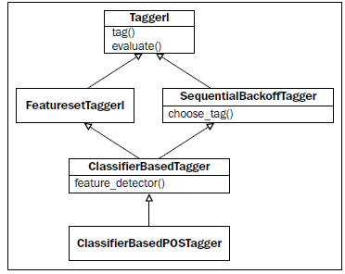
Classifier-Based Tagger
A Classifier-Based Tagger is a type of Part-of-Speech (POS) tagger that uses machine learning classifiers (like Naive Bayes, Decision Trees, MaxEnt) to predict tags based on features extracted from the context of each word.
How It Works Internally
For each word, features are extracted based on:
The current word
Previous and next words
Previous tags
Word shape (capitalization, punctuation, etc.)
The classifier (default: Naive Bayes) is trained on these features and the correct tag.
During tagging, it uses the learned patterns to predict the tag of each word.
>>> from nltk.tag.sequential import ClassifierBasedPOSTagger
>>> tagger = ClassifierBasedPOSTagger(train=train_sents)
>>> tagger.evaluate(test_sents)

Slide 40
Training a tagger with NLTK-Trainer
NLTK-Trainer is a command-line tool built on top of NLTK that makes training, evaluating, and using NLP models (like POS taggers, classifiers, etc.) easier and faster.
No need to write long Python scripts.
Train and evaluate models with a single command.
Steps
1. Prepare Data
You need a dataset in NLTK format, e.g., list of tagged sentences:
[[('The', 'DT'), ('cat', 'NN'), ('sat', 'VBD'), ('on', 'IN'), ('the', 'DT'), ('mat', 'NN')]]
Save it as a .pickle or .json file.
2. Install nltk-trainer
If not installed:
pip install nltk-trainer

Slide 41
Training a tagger with NLTK-Trainer
3. Train the Tagger
Use the command line to run:
train_tagger.py models/tagger.pickle --train data/train.pickle
You can also specify:
Type of tagger: --tagger (default is sequential)
Class of tagger: --sequential-class (e.g., UnigramTagger, BigramTagger, TnT, ClassifierBasedTagger)
Use a backoff chain: --sequential-backoff
Example:
train_tagger.py models/tagger.pickle \
--train data/train.pickle \
--sequential-class BigramTagger \
--sequential-backoff UnigramTagger
4. Evaluate the Tagger
Use:
eval_tagger.py models/tagger.pickle data/test.pickle

Slide 42
Self Study Topics
Training the TnT tagger,
Using WordNet for tagging
Tagging proper names

